Slide 1
Chapter 13: Advanced Laptops and Portable Devices
IT Essentials: PC Hardware and Software v4.1
Notes:
Cisco Networking Academy program
IT Essentials: PC Hardware and Software v4.1
Chapter 13: Advanced Laptops and Portable Devices

Slide 2
Chapter 13 Objectives
13.1 Describe wireless communication methods for laptops and portable devices
13.2 Describe repairs for laptops and portable devices
13.3 Select laptop components
13.4 Describe preventive maintenance procedures for laptops
13.5 Describe how to troubleshoot a laptop
Notes:
Chapter 13 Objectives
With the increase in demand for mobility, the popularity of laptops and portable devices will continue to grow. Servicing laptops can be very challenging. Mastering the skills necessary to work on laptops is important to career advancement in the fields of PC hardware and software support.

Slide 3
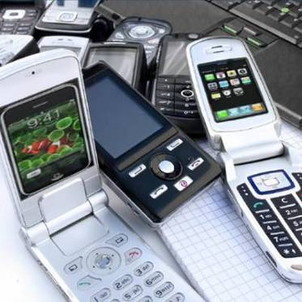
Introduction
With the increase in demand for mobility, the popularity of laptops and portable devices will continue to grow.
A technician should be able to configure, optimize, and troubleshoot laptops, portable
devices, docking stations and
accessories.
Some laptop manufacturers
require technicians complete
specialized certification
training to perform laptop
repairs.
Notes:
13.0 Chapter Introduction
The knowledge you acquire about desktop computers will help you service laptops and portable devices. However, there are important differences between the two technologies.
To facilitate mobility, laptops and portable devices use wireless technologies more than desktops.
Servicing laptops can be very challenging. Mastering the skills necessary to work on laptops is important to your career advancement.

Slide 4
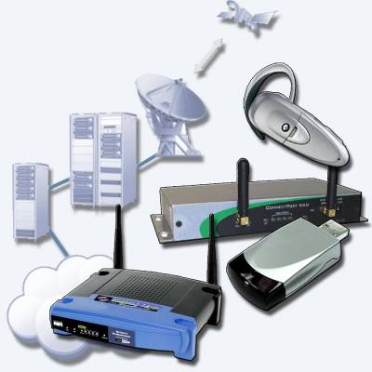
Wireless Communication Methods
13.1 Describe wireless communication methods for laptops and portable devices
Bluetooth
Infrared
Cellular WANs
Wi-Fi
Satellite
Notes:
13.1 Describe wireless communication methods for laptops and portable devices
People using wireless-capable devices do not need to be tied to a physical location to send and receive voice, video, and data communications. College campuses use wireless networks to allow students to sign up for classes, watch lectures, and submit assignments in areas where physical connections to the network are unavailable.
Wireless access to the Internet enables people to communicate with others and exchange data from many, random, spontaneous locations as opposed to a fixed access point (wired) like a desk or phone booth.
Most wireless communications systems communicate using radio waves. Some use light.
Wireless card – discuss generically using Windows client. Wireless technologies are less secure than wired technologies.
[Laptops and portable devices can connect to the Internet using various wireless technologies. Each wireless technology has pros and cons for its implementation.]

Slide 5
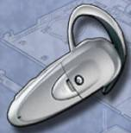
Bluetooth Technology
A short-range wireless technology designed to eliminate the need for cables between portable or fixed-configuration devices
Operates at 2.4 to 2.485 GHz in the unlicensed Industrial, Scientific, and Medical (ISM) band
Low power, low cost, and small size
Uses adaptive frequency hopping
(AFH)
Speeds:
  Version 1.2 – up to 1.2Mbps
  Version 2.0 + EDR – up to 3Mbps
  Version 3.0 + HS – up to 24Mbps
Notes:
13.1.1 Describe Bluetooth technology
Bluetooth is a wireless technology that enables devices to communicate over short distances. A Bluetooth device can connect up to seven other Bluetooth devices to create a wireless personal area network (WPAN). Bluetooth devices are capable of handling voice, music, video, and data and are ideally suited for connecting the following devices: laptops, printers, cameras, PDAs, cell phones, and hands-free headsets.
The distance of a Bluetooth personal area network (PAN) is limited by the amount of power used by the devices in the PAN. Bluetooth devices are broken into three classifications. The most common Bluetooth network is Class 2, which has a range of approximately 33 feet (10 m).
AFH allows signals to "hop" around using different frequencies within the Bluetooth range, thereby reducing the chance of interference when multiple Bluetooth devices are present. AFH also allows the device to learn frequencies that are already in use and to choose a different subset of frequencies hopping.
Security measures are included in the Bluetooth standard. The first time that a Bluetooth device connects, the device is authenticated using a personal identification number (PIN). Bluetooth supports both 128-bit encryption and PIN authentication.

Slide 6
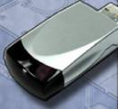
Infrared (IR) Technology
A short-range, low-throughput wireless technology used as a data transmission medium.
Infrared light signals operate in the lowest light frequency, typically between 100GHz to 1000THz.
Distances are limited to a few feet or meters.
IR cannot penetrate any object that blocks the light signal.
Notes:
13.1.2 Describe infrared technology
Infrared (IR) wireless technology is susceptible to interference and dilution. Scatter IR can connect without line of sight but data transfer rates are lower and distances are shorter. Security concerns are not applicable to IR. There are four types of IR networks:
1) Line of sight – Signal is transmitted only if there is a clear, unobstructed view between devices
2) Scatter - Signal is bounced off ceilings and walls
3) Reflective - Signal is sent to an optical transceiver and is redirected to the receiving device.
4) Broadband optical telepoint - Transmission can handle high-quality multimedia requirements.
Infrared networks are ideal for connecting laptops to the following types of devices that are in close proximity: multimedia projector, PDA, printer, remote control, wireless mouse, and wireless keyboard.
Many IR devices connect to the USB port on a laptop or desktop computer. The installation is similar to setting up a local area network connection.
IR is a practical, short-range connection solution, but it has some limitations:
IR light cannot penetrate ceilings or walls.
IR signals are susceptible to interference and dilution by strong light sources, such as florescent lighting.
Scatter IR devices are able to connect without the line of sight, but data transfer rates are lower and distances are shorter.
IR distances should be 3 feet (1 m) or less when used for computer communications.

Slide 7
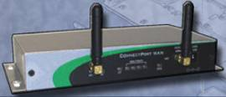
Cellular WAN Technology
Cellular WAN connections are powerful, 2-way wireless networks that have been around since the late 1970s.
Cellular networks operate in one of two ranges:
  Approximately 800 MHz
  Approximately 1900 MHz
Three generations of cellular WAN include voice-only analog, digital, and high-speed data and voice.
Notes:
13.1.3 Describe cellular WAN technology
Cellular WAN technology originally only transmitted voice but now is capable of transmitting voice, video, and data simultaneously. Laptops, cell phones, PDAs, and smartphones can connect to a cellular WAN as long as the cellular tower is not more than several miles away.
Although slower than DSL and cable connections, cellular WANs are still fast enough to be classified as a high-speed connection. To connect a laptop to a cellular WAN, you should install an adapter that is designed to work with cellular networks. A cellular adapter needs to support some or all of the following:
Global System for Mobile Communications (GSM) – Worldwide cellular network
General Packet Radio Service (GPRS) – Data service for users of GSM
Quad-band – Allows a cellular phone to operate on all four GSM frequencies: 850 MHz, 900 MHz, 1800 MHz, and 1900 MHz
Short Message Service (SMS) – Text messages
Multimedia Messaging Service (MMS) – Multimedia messages
Enhanced Data Rates for GSM Evolution (EDGE) – Provides increased data rates and improved data reliability
Evolution-Data Optimized (EV-DO) – Faster download rates
High Speed Downlink Packet Access (HSDPA) – Provides enhanced G3 access speed

Slide 8
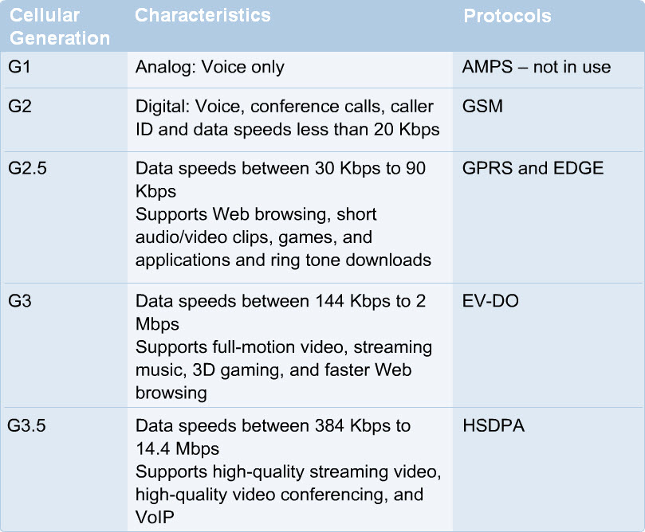
Cellular WAN Generations
Notes:
13.1.3 Describe cellular WAN technology
Cellular WAN cards are Plug and Play (PnP). These cards plug in to the PC Card slot or are built in to the laptop.

Slide 9
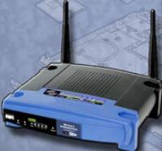
Wireless Fidelity (Wi-Fi) Technology
Wi-Fi is a wireless technology that provides a simple connection from anywhere within the range of a base station.
Connection distances of 300 feet (91 meters) or more, depending on the environment.
Ease of access makes Wi-Fi a simple solution for network connectivity.
Notes:
13.1.4 Describe Wi-Fi technology
The wireless technology Wi-Fi is based on IEEE 802.11 networking standards and specifications. The number 802.11 denotes a set of standards that are specified in the IEEE 802.11 documentation. The terms 802.11 and Wi-Fi are interchangeable.
The 802.11g standard was released in 2003 and is currently the most common Wi-Fi standard. The 802.11n standard was released in draft form in 2006 and ratified in 2009.
There are currently four major Wi-Fi, 802.11 standards: 802.11a, 802.11b, 802.11g, and 802.11n (draft standard). The 802.11b, 802.11g, and 802.11n standards use the 2.4 GHz frequency band. The 2.4 GHz frequency band is unregulated and heavily used. For this reason, the 802.11a standard was designed to use the 5.0 GHz frequency band. As a result, 802.11a is only compatible with the 802.11n standard because it also supports the 5.0 GHz frequency.
Security is a major concern for wireless networks. Anyone within the coverage area of a wireless router can potentially gain access to the network. Security features of Wi-Fi include VPNs, WPA (encryption and authentication), and other security settings.
Wi-Fi Protected Access standards (WPA, WPA2) are used to secure Wi-Fi networks. WPA uses a sophisticated encryption and authentication technology to protect data flow between Wi-Fi devices. WPA uses a 128-bit encryption key and should be enabled on all wireless devices. WPA was introduced to replace wired equivalent privacy (WEP), which had known security issues.

Slide 10

Satellite Technology
Satellite networks are faster than dial-up connections but slower than Cable and DSL connections.
Satellite service is ideal for the rural or remote Internet users.
Downloading files is faster than uploading files.
Adverse weather conditions can interfere with satellite reception.
Notes:
13.1.5 Describe satellite technology
A satellite provides up to 5,000 channels of communication simultaneously. Satellite offers slower speeds than DSL or cable and has higher initial cost.
Satellite Internet connections use two-way data channels. One channel is used for uploading and another for downloading. Download speeds are typically in the 500 Kbps range, while uploads are around 50 Kbps, making this an asymmetrical connection similar to DSL. Connecting by satellite has some advantages:
Two-way, high-speed Internet access, available in rural and remote areas
Quick file downloads
Satellite dish may be also be used for TV access
Proper placement, installation, and configuration of a satellite system are important for the system to work effectively. Even if you point the satellite dish toward the equator where most satellites orbit the Earth, obstructions and adverse weather can still interfere with signal reception.
Specific equipment is needed to set up a satellite connection.
Student Activity: Wireless Technologies (The student course content includes a matching activity in 13.1.5. To complete this activity, students will match the wireless technology to the appropriate descriptive phrase.)

Slide 11
Repairing Laptops and Portable
Customer Replaceable Units (CRUs) can be replaced by the customer.
Field Replaceable Units (FRUs) should only be replaced by a qualified field technician.
  There are more repair center and manufacturer repairs with laptops than desktops.
  A technician at a repair center can provide standard service on laptops made by different manufacturers, or a repair center may specialize in a specific brand and be considered an authorized dealer for warranty work and repair.
  If no local services are available, the laptop may need to be sent to a regional repair center or to the manufacturer. If the laptop damage is severe or requires specialized software and tools, the manufacturer can decide to replace the laptop instead of attempting a repair.
Notes:
13.2 Describe repairs for laptops and portable devices
Common Errors: For FRUs, there may be warranty distance limitations for free repairs.
Student Activity: The student course content includes the worksheet, 13.2 Investigating Repair Centers. To complete this worksheet, students will investigate services provided by a computer repair center and then answer questions about the results of the research.
CAUTION: Before attempting to repair a laptop or portable device, check the warranty to see if repairs during the warranty period must be done at an authorized service center to avoid invalidating the warranty. If you repair a laptop yourself, you should always back up the data and disconnect the device from the power source.

Slide 12
Selecting Replacement Components
Laptop components need to be replaced for the following reasons:
  The original parts are damaged.
  Additional functionality is required.
  Improved performance is required.
New components must fit both physically and electrically.
Components fall into two categories:
  Retail packaged components usually come with documentation, full warranty, cables, mounting hardware, drivers, and software.
  Original Equipment Manufacturer (OEM) components are usually sold without packaging. OEM components require the user to locate documentation, software, drivers, and any additional hardware that may be needed.
Notes:
13.3 Select laptop components
After completing this section, students will meet the following objectives:
Select batteries
Select a docking station or port replicator
Select storage devices
Select additional RAM

Slide 13
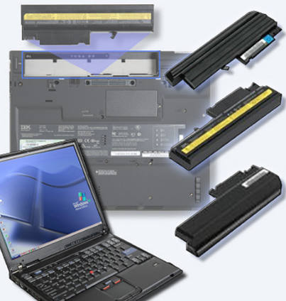
Selecting Batteries
How do you know when you need a new laptop battery?
  Laptop shuts off immediately when AC power is removed
  Battery is leaking
  Battery overheats
  Battery does not hold a charge
Notes:
13.3.1 Select batteries
If you experience problems that you suspect are battery related, exchange the battery with a known, good battery that is compatible with the laptop. If a replacement battery cannot be located, take the battery to an authorized repair center for testing.
[Guidelines for selecting a replacement battery include that the replacement battery 1) matches the model of the laptop, 2) fits the laptop, 3) is compatible with battery connection, and 4) has correct voltage requirements.]
NOTE: Always follow the instructions provided by the manufacturer when charging a new battery. The laptop can be used during an initial charge, but do not unplug the AC adapter. Ni-Cad and NiMH rechargeable batteries should occasionally be discharged completely to remove the charge memory. When the battery is completely discharged, it should then be charged to maximum capacity.
CAUTION: Care should always be taken when handling batteries. Batteries can explode if improperly charged, shorted, or mishandled. Be sure that the battery charger is designed for the chemistry, size, and voltage of your battery. Batteries are considered toxic waste, and must be disposed of according to local laws.
Student Activity: The student course content includes the worksheet, 13.3.1 Laptop Batteries. To complete this worksheet, students will conduct research for a replacement battery for a specified laptop. The student will list the specifications of the battery, shop around for a replacement battery, and then make a recommendation for one battery over another and explain the decision.

Slide 14
Select a Docking Station/Port Replicator
Docking stations and port replicators increase the number of ports available to a laptop. A docking station has the same ports as a port replicator, but adds the ability to connect to PCI cards, additional hard drives, optical drives, and floppy drives.
The addition of new devices when docking can be handled by using PnP technology that recognizes and configures the newly added components, or by having a separate hardware profile for the docked and undocked state.
Many docking stations and port replicators are proprietary and only work with particular laptops. Before buying a docking station or port replicator, check the laptop documentation, or the website of the manufacturer to determine the appropriate make and model for the laptop.
Notes:
13.3.2 Select a docking station or port replicator
A port replicator may contain a SCSI port, a networking port, PS/2 ports, USB ports, and a game port.
[Guidelines for selecting a docking station or port replicator include that it matches the model of the laptop, fits the laptop, and is compatible with docking connection.]
Student Activity: The student course content includes the worksheet, 13.3.2 Docking Station. To complete this worksheet, students will conduct research for a docking station for a specified laptop. The student will list the specifications, shop around for a docking station, and then answer questions based on the research.

Slide 15
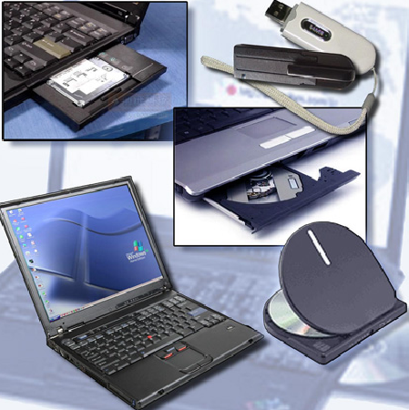
Select Storage Devices
Storage devices are CRUs, unless a warranty requires technical assistance.
External USB hard drive
Firewire hard drive
BD/DVD/CD burner
Notes:
13.3.3 Select storage devices
[Guidelines for selecting a replacement storage device include the following; comparing proprietary drive compatible with laptop model vs. generic external drives, matches the model of the laptop, fits the laptop, and is compatible with laptop drive bay.]
Before purchasing a new internal or external hard drive, check the laptop documentation or the website of the manufacturer for compatibility requirements. Documentation often contains Frequently Asked Questions (FAQs) that may be helpful. It is also important to research known laptop component issues on the Internet.
On most laptops, the internal hard drive and the internal optical drive are connected behind a cover on the underside of the case. However, on some laptops, the keyboard must be removed to access these drives. It is important to note that Blu-ray, DVD, and CD drives may not be interchangeable in the laptop.
To confirm the currently installed storage device, check the POST screen or BIOS. If installing a second hard drive or an optical drive to the laptop, confirm proper installation in the Device Manager window:
Use the following path in Windows XP: Start > Control Panel > System > Hardware tab > Device Manage.
Use the following path in Windows Vista: Start > Control Panel > System > Device Manage.
Student Activity: The student course content includes the worksheet, 13.3.3 Research DVD Drives. To complete this worksheet, students will conduct research for an internal DVD/RW drive and an external DVD/RW drive for a specified laptop. The student will list the features and cost for each, list the advantages for each, and then make a recommendation for one over the other and explain the decision.

Slide 16
Select Additional RAM
Additional RAM improves laptop performance.
Most laptops use a Small Outline DIMM (SODIMM). When replacing or adding memory, determine if the laptop has available slots to add memory, and that the laptop supports the quantity and type of memory to be added.
Before purchasing and installing additional RAM, consult the laptop documentation or the website of the manufacturer for form-factor specifications. Use the documentation to find where to install RAM on the laptop. On most laptops, RAM is inserted into slots behind a cover on the underside of the case.
Notes:
13.3.4 Select additional RAM
Additional RAM improves performance by:
Decreasing the number of times the OS reads and writes data to the hard drive swap file.
Reading and writing data directly from RAM
Helping the OS run multiple applications more efficiently
Reading and writing data directly from RAM is faster than using swap files. Also, RAM helps the operating system run multiple applications more efficiently.
On some laptops, the keyboard must be removed to access the RAM slots.
CAUTION: Before installing RAM, remove the battery and unplug the computer from the electrical outlet to avoid damage related to ESD when you are installing memory modules.
To confirm the currently installed amount of RAM, check the POST screen, BIOS, or System Properties window. To confirm the amount of RAM examine the System Properties window: Start > Control Panel > System > General Tab
Teaching Strategy: Guidelines for selecting expansion RAM include the following; comparing proprietary RAM compatible with laptop model vs. generic RAM, the RAM must match the model of the laptop, fit the laptop, and be compatible with the laptop RAM slots. Pre-installed RAM may come with RAM already soldered to the motherboard and can't be replaced except by the manufacturer.
Student Activity: The student course content includes the worksheet, 13.3.4 Laptop RAM. To complete this worksheet, students will conduct research for RAM for a specified laptop. The student will list the specifications, shop around, and then answer questions based on the research.

Slide 17
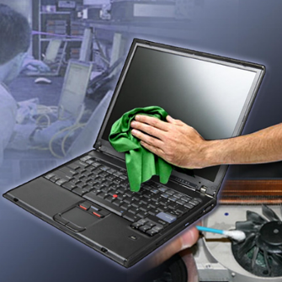
Laptop Preventive Maintenance
Preventive maintenance should be scheduled at regular intervals to keep laptops running properly. Because laptops are portable, they are more likely to be exposed to harmful materials and situations than desktop computers.
Clean the laptop
Perform hard drive
maintenance
  Disk Cleanup
  Disk Defragmenter
Update software
Notes:
13.4 Describe preventive maintenance procedures for laptops
[Preventive maintenance will extend the life of the equipment and decrease the chance of failure. Establish file versioning policies to avoid accidentally overwriting data.]
CAUTION: Before you clean a laptop, disconnect it from all power sources.
1) A laptop should be cleaned at the following times:
regular scheduled cleaning as suggested by business policy e.g. clean and inspect monthly
anytime the laptop goes in for service
when the laptop has been operating in extreme environments
2) A routine OS update schedule for a laptop includes:
regular scheduled update
anytime the laptop goes in for service
3) Before cleaning the laptop, shut down the laptop, disconnect any attached devices, and disconnect them from their electrical outlets.
Follow the appropriate cleaning procedures for laptops.
Caution: To avoid damaging the computer or display, do not spray cleaning solution directly on them. Moisten the cleaning cloth. Only use products specifically designed for cleaning LCD displays. Never use solutions that contain ammonia.

Slide 18
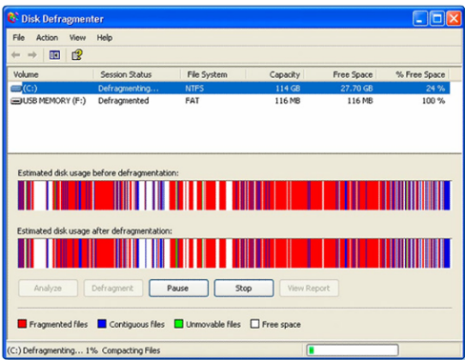
Disk Cleanup and Disk Defragmenter
The computer can slow down if the OS is searching through fragmented files.
Windows has two programs that help clean up the hard drive:
  Disk Cleanup
  Disk Defragmenter
Notes:
13.4.1 Describe how to schedule and perform maintenance for laptops
The preventive maintenance schedule should include these standard procedures; cleaning, hard drive maintenance, and software updates.
The hard drive can become disorganized as files are opened, saved, and deleted.
Disk Cleanup is used to scan a hard drive for files that are not needed, such as temporary files and cached Internet sites. Other files that are saved, deleted, or modified, are fragmented across various locations on the hard drive.
Disk Defragmenter places files in adjacent clusters for faster access.
NOTE: It may be necessary to close all programs running in the background before running Disk Defragmenter.

Slide 19
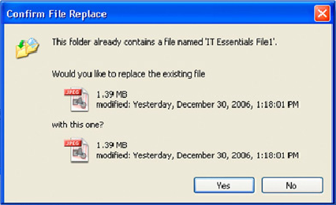
File Management and Version Control
When moving files from a laptop to a desktop computer, be careful that data copied from one computer does not inadvertently overwrite data on the other computer.
Notes:
13.4.2 Explain how to manage data version control between desktops and laptops
[Have your students develop a file naming structure. A file name in a particular folder must be unique. Be cautious when transferring files so not to overwrite a file you wish to keep. Have student use notepad to create a file and save the file using the given file name structure. The file is then opened and updated and saved again as the same file name. When the student tries to retrieve the original content of file, they should see the original content has changed.]
To ensure data integrity, it is critical that data files and folders are properly managed. Restore and recover procedures, as well as backups, are more successful if the data is organized.
When moving files from a laptop to a desktop computer, start by creating a similar folder structure in both locations. Files can be transferred over a network, with an optical disc, or with a portable drive.
You should be careful that data copied from one computer does not inadvertently overwrite data on the other computer. When you are copying a file to a destination folder, you might encounter a “Confirm File Replacement” message. This message indicates that Windows XP has stopped the copying process until you choose whether to replace or not to replace the original file with the file that is being transferred. If you are unsure, select “No”. To determine which file to keep, compare the dates and file size. You may also open the files to view their content.
NOTE: No operating system allows files with the same name to exist in the same folder.
CAUTION: Be careful not to unintentionally “cut” a file from its original location when you only meant to “copy” it.

Slide 20
Troubleshooting Process
Step 1 Identify the problem
Step 2 Establish a theory of probable causes
Step 3 Determine an exact cause
Step 4 Implement a solution
Step 5 Verify solution and full system functionality
Step 6 Document findings
Notes:
13.5 Describe how to troubleshoot a laptop
[Most of the troubleshooting issues found in desktops also occur in laptops. The procedures will also typically be the same.]

Slide 21
Step 1 - Identify the Problem
Laptop information
  Manufacturer, model, OS, network environment, connection type
Open-ended questions
  Which specific computer resources are you trying to access with your laptop?
  Are there any laptop resources that you can access?
  When were you last able to access the resources?
Closed-ended questions
  Is your network cable plugged in?
  Does anyone else have this problem?
  Have you changed your password recently?
  Have you received any error messages on your laptop?
Notes:
13.5.1 Review the troubleshooting process
Identify the Problem

Slide 22
Step 2 - Establish a Theory of Probable Causes
The Problem may be simpler than the customer thinks.
Create a list of the most common reasons why the error would occur.
  Is the laptop plugged in with the AC adapter?
  Is the battery secure?
  Is the power switch turned on?
  Have there been any power outages?
  Have any cables been unplugged?
  Are the cables or connectors damaged?
Notes:
13.5.1 Review the troubleshooting process
Establish a Theory of Probable Causes

Slide 23
Step 3 - Determine the Exact Cause
Test your theories of probable causes one at a time, starting with the quickest and easiest.
  Reboot
  Install a known good network cable to this computer
  Boot in safe mode using the F8 menu
  Boot to last known good configuration using the F8 menu
  Boot from startup disk
If the exact cause of the problem has not been determined after you have tested all your theories, establish a new theory of probable causes and test it.
Notes:
13.5.1 Review the troubleshooting process
Determine the Exact Cause

Slide 24
Step 4 - Implement a Solution
Sometimes quick procedures can determine the exact cause of the problem or even correct the problem.
If a quick procedure does not correct the problem, you might need to research the problem further to establish the exact cause.
Divide larger problems into smaller problems that can be analyzed and solved individually.
Notes:
13.5.1 Review the troubleshooting process
Implement a Solution
If a quick procedure does correct the problem, you can go to step 5 to verify the solution and full system functionality.
Evaluate the problem and research possible solutions. Divide larger problems into smaller problems that can be analyzed and solved individually. Prioritize solutions starting with the easiest and fastest to implement.
Check:
Helpdesk repair logs
Other techs
Manufacturer FAQs
Technical websites
News groups
Computer manuals
Device manuals
Online forums
Internet search

Slide 25
Step 5 - Verify Solution and System Functionality
Verifying full system functionality and implementing any preventive measures if needed. Ensures that you have not created another problem while repairing the computer.
  Reboot the laptop
  Attach all peripherals
  Operate laptop using only battery
  Print a document from an application
  Type sample document to test keyboard
  Check Event Viewer for warnings or errors
Have the customer verify the solution and system functionality.
Notes:
13.5.1 Review the troubleshooting process
Verify Solution and System Functionality
NOTE: Never ask a customer to reveal a password. If you need to access a computer and the customer cannot stay nearby, have the customer create a temporary password. Advise the customer to reset the password when the repair is complete.

Slide 26
Step 6 - Document Findings
Discuss the solution with the customer
Have the customer confirm that the problem has been solved
Document the process
  Problem description
  Solution
  Components used
  Amount of time spent in solving the problem
Notes:
13.5.1 Review the troubleshooting process
Document Findings

Slide 27
Common Problems and Solutions
Laptop problems can be attributed to hardware, software, networks, or some combination of the three. You will resolve some types of laptop problems more often than others.
Notes:
13.5.2 Identify common problems and solutions
[Direct the students to the curriculum to see all the charts explaining more common problems and solutions]
Common laptop problems and possible causes to consider:
Problem: A laptop user complains that numerous peripheral cables are constantly getting tangled.
Possible solution: Provide information to the user about cordless peripherals.
Problem: A laptop user is unable to connect to the wireless network.
Possible solution: Reconfigure the wireless security on the laptop to connect to the security system used by the network.
Problem: The laptop keyboard no longer works.
Possible solution: The keyboard is a FRU. Advise the customer to take the laptop to a repair center or return it to the manufacturer.
Problem: A user reports that the laptop battery needs recharging more frequently than when it was new.
Possible solution: Have the user completely discharge the battery, then fully recharge it.
Problem: A user obtains a new laptop and reports that it does not fit in the existing docking station.
Possible solution: Docking stations are proprietary. Verify that the user has a compatible model.

Slide 28

Apply Troubleshooting Skills
Now that you understand the troubleshooting process, it is time to apply your listening and diagnostic skills.
The worksheet is designed to reinforce your communication skills to
verify information from
the customer.
The optional labs are
designed to reinforce
your troubleshooting skills.
Notes:
13.5.3 Apply troubleshooting skills
Student Activity: The student course content includes two worksheet:
13.5.3 Worksheet: Verify Work Order Information. To complete this worksheet, students will verify information that a level-one tech has documented in a work order.
13.5.3 Worksheet: Investigating Support Websites and Repair Companies. To complete this lab, students will investigate the services provided by a local laptop repair company or a laptop manufacturer support website.
Student Activity: The student course content includes two optional labs:
13.5.3 Optional Lab: Troubleshooting laptop Problems in Windows XP. To complete this lab, students will diagnose solve, and document various laptop problems.
13.5.3 Optional Lab: Troubleshooting laptop Problems in Windows Vista. To complete this lab, students will diagnose solve, and document various laptop problems.

Slide 29
Chapter 13 Summary
Some of the important concepts to remember from this module:
Bluetooth creates a small wireless PAN for connected cell phones, printers, and laptops.
An IR network uses infrared light to create short-range networks that are primarily used to control input devices and mobile devices.
A cellular WAN allows you to use your cell phone and laptop for voice and data communications.
The most popular wireless technology is Wi-Fi. There are four major Wi-Fi releases, each with different speed and bandwidth ratings: IEEE 802.11 a, b, g, and n.
Satellite networks are faster than modems, but slower than DSL and cable networks. Satellite networks are primarily used in remote locations.
Notes:
13.6 Summary

Slide 30
Chapter 13 Summary (Continued)
Some of the important concepts to remember from this module:
A CRU is a component that a user can easily install without technical training.
A FRU is a component that a trained service technician may install at a remote location.
Most repairs can be done at customers’ sites or at any local repair center. However, there are occasions when a laptop must be sent directly to the manufacturer for repairs.
Professional technicians follow preventive maintenance schedules to keep their equipment at optimal performance levels.
Laptops are more susceptible to contamination and damage. A well-maintained laptop will reduce repair costs.
Notes:
13.6 Summary

Slide 31
Chapter 13 Summary (Continued)
Some of the important concepts to remember from this module:
A docking station allows a laptop to easily connect to peripheral devices similar to those found on desktop computers. A port replicator can be added to a laptop if the user needs more I/O ports.
Mastering the steps in troubleshooting laptop problems is considered a career milestone by many technicians.
A well-trained technician must possess good customer communications skills.
Notes:
13.6 Summary

Slide 32


